Slide 1

SIGMUM
Stitch perfect:
Suturing Workshop
April 18th, 2026
Clinical School Johor Bahru
Monash University Malaysia

Slide 2
Sutures
Dr. Anil Gandhi
Assoc. Prof. Surgery
Monash university Malaysia
SIGMUM

Slide 3
Sutures
A strand of material used to approximate (sew) or to ligate (tie) tissues
SIGMUM

Slide 4
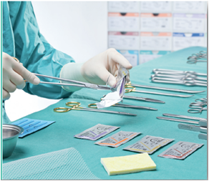
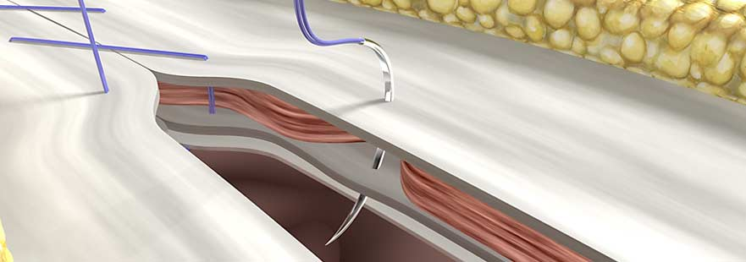
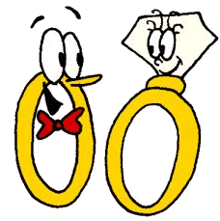
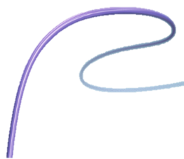
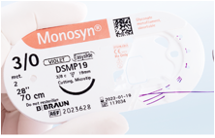
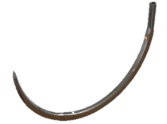
What is a SUTURE? What is it used for?
Surgical suture is a medical device composed by a needle and a thread use to hold body tissues together after an injury or surgery.
SIGMUM

Slide 5
Sutures
Ideal Suture
Adequate strength retention with secure wound support throughout the critical wound healing period
Rapid absorption
High tensile strength

Slide 6
Sutures
Ideal Suture
Minimal tissue reaction
Predictable performance
Sterile
Consistent uniform diameter
SIGMUM

Slide 7
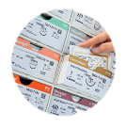
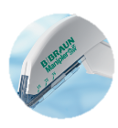

Wound Closure –
Common Options
Traditional sutures
Mechanical skin stapler
Histoacryl Tissue adhesives
SIGMUM

Slide 8
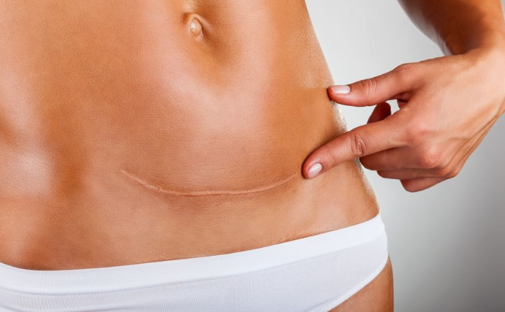
The Goal for Wound closure
Why Should We Care about Cosmesis ?
Preventing Abnormal Scarring (Elevated, Depressed, Keloids, Hypertrophic)
Occurs in: Skin
Skin
Cosmesis
Minimize tissue trauma
Achieve excellent wound approximation
SIGMUM

Slide 9

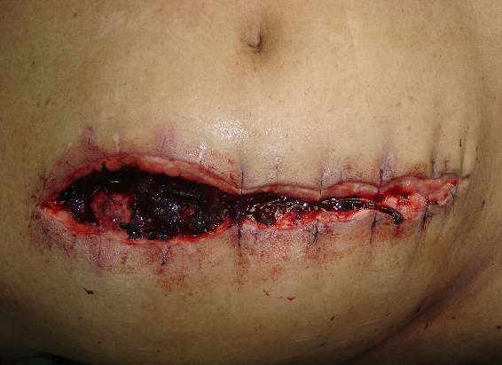
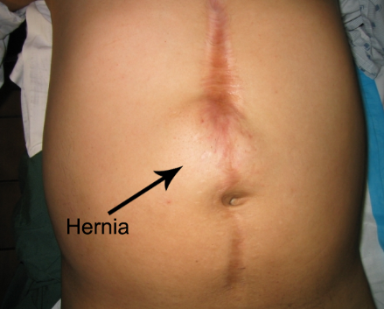
Why Should We Care about Strength ?
Preventing Wound Dehiscence and Hernia
Occurs in: Skin & Fascia
Fascia/Muscle
Closure strength
Appropriate strength during critical healing period
Good Absorption profile
SIGMUM

Slide 10
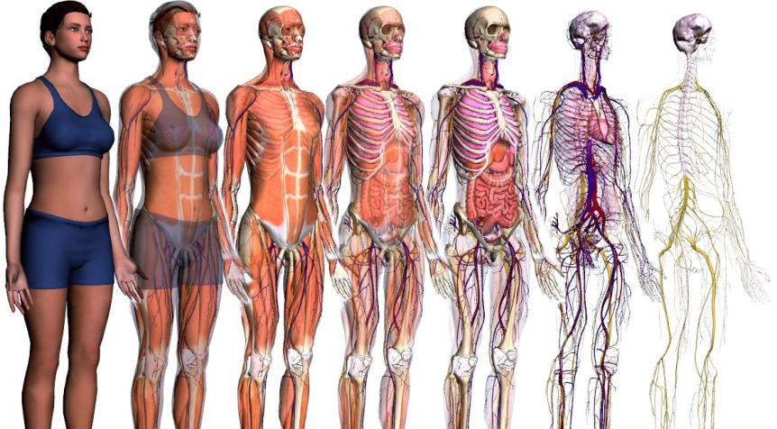
Surgical Layers
MUSCULAR
ORGANS
NERVOUS
SKIN
FAT TISSUE
VASCULAR
BONE
SIGMUM

Slide 11
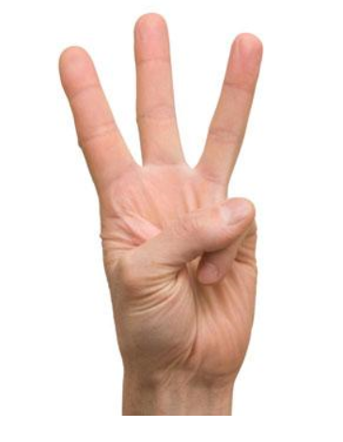


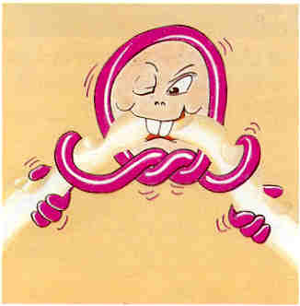
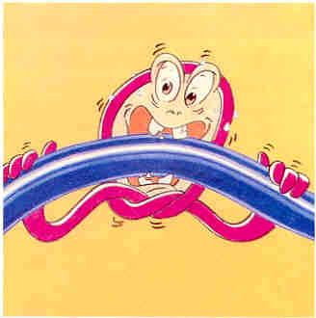
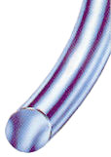
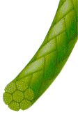
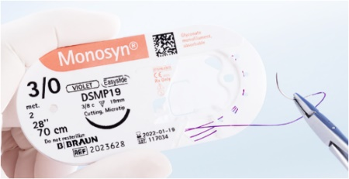
Suture Classification
Natural
or
Synthetic
Absorbable
Or
Non-Absorbable
Monofilament
or
Braided
SIGMUM

Slide 12
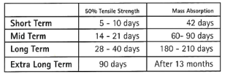
Suture Portfolio
Sutures
Absorbable
Non-Absorbable
Natural
Synthetic
Monofilament
Monofilament
Braided
Short term
Monosyn® Quick
Mid Term
Monosyn®
Long Term
MonoPlus®
Extra Long Term
Monomax®
Short Term
Novosyn® Quick
Mid Term
Novosyn®
Short Term
Catgut® Plain
Mid Term
CatgChromut®
Natural
Synthetic
Monofilament
Braided
Steelex®
Silkam®
Monofilament
Braided
Optilene®
PremiCron®
Dafilon®
SIGMUM

Slide 13
Classification
Absorbable
Or
Non-Absorbable
Absorbable
Absorbed rapidly
Broken down by body via enzymatic reaction or hydrolysis
Commonly used for tissue that heal rapidly
Soft tissue, bowel
Permanent wound support
Non-Absorbable
Inert and provide less inflammation and reduced scarring
Commonly used for skin and with tissue that heal slowly
Require manual removal post-op for skin
Tendon, vessel anastomosis
Natural
or
Synthetic
Monofilament
or
Braided
SIGMUM

Slide 14
Classification
Absorbable
Or
Non-Absorbable
Natural
Made of natural fibres (silk, catgut)
Provoke greater tissue reaction
Absorption by enzymatic
Synthetic
Man-made materials
Minimal tissue reaction
Predictable in loss of tensile strength and absorption
Absorption by hydrolysis
Natural
or
Synthetic
Natural
or
Synthetic
Monofilament
or
Braided
SIGMUM

Slide 15
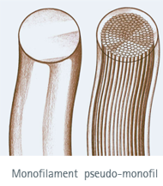
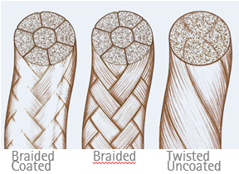
Classification
Natural
or
Synthetic
Monofilament
Single strand / One filament
No capillary action
Less infection risk
Smooth tissue passage
Minimal tissue trauma
High tensile strength
Possesses memory
More throws required
Braided
Fibers are twisted are braided together
Capillary action
Increased infection risk
Less smooth passage
High tensile strength
Good handling and ease of tying
Fewer knots required
Absorbable
Or
Non-Absorbable
Monofilament
or
Braided
SIGMUM

Slide 16
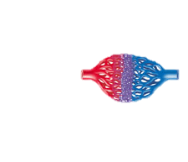
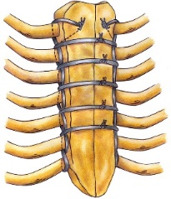
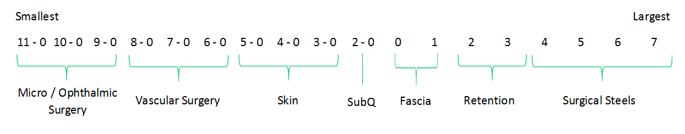

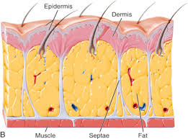
Suture Sizes
USP
USP
SIGMUM

Slide 17

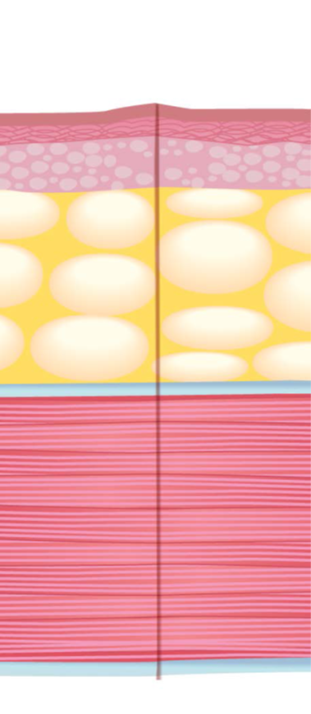

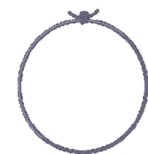
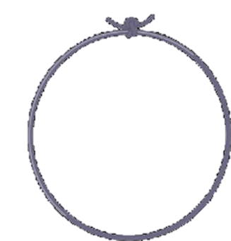
Suture Sizes
Cuticular
Histoacryl®
4
Skin
Size 3/0 – 5/0
Small
3
SubQ
Size 2/0 – 3/0
2
Suture size
Fascia
Size 1 – 2/0
1
Large
SIGMUM

Slide 18
Tissue Reaction
Catgut Chrome*
Catgut Plain*
Silk*
Twine*
Polyester* (braided, uncoated)
Polyester* (braided, coated)
Polyamide* (braided, coated)
Synthetic absorbable (braided, coated)
Synthetic absorbable (monofilament)
Polyamide (monofilament)
Polypropylene (monofilament)
Steel wire (monofilament)
Titanium (inert)
Natural
Synthetic Monofilament
* Strong reaction in tissue
Absorption via hydrolysis causes less tissue reaction than enzymatic degradation
SIGMUM

Slide 19
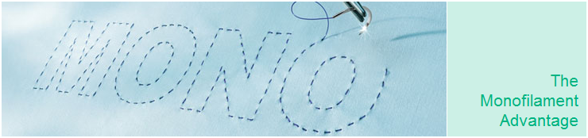
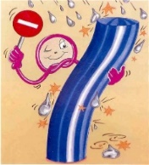
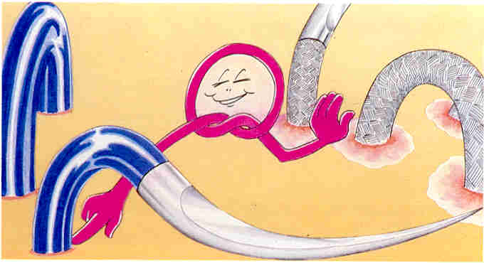
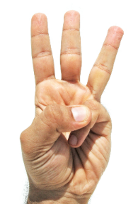
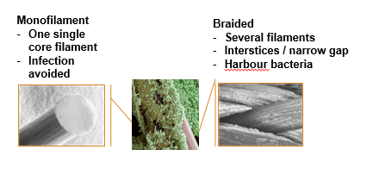
Why use a Monofilament?
Less infection promoting effect¹,²
Smooth passage through the tissue²
Secure knot and high knot tensile strength
Simple Knot pull tensile strength
SIGMUM

Slide 20
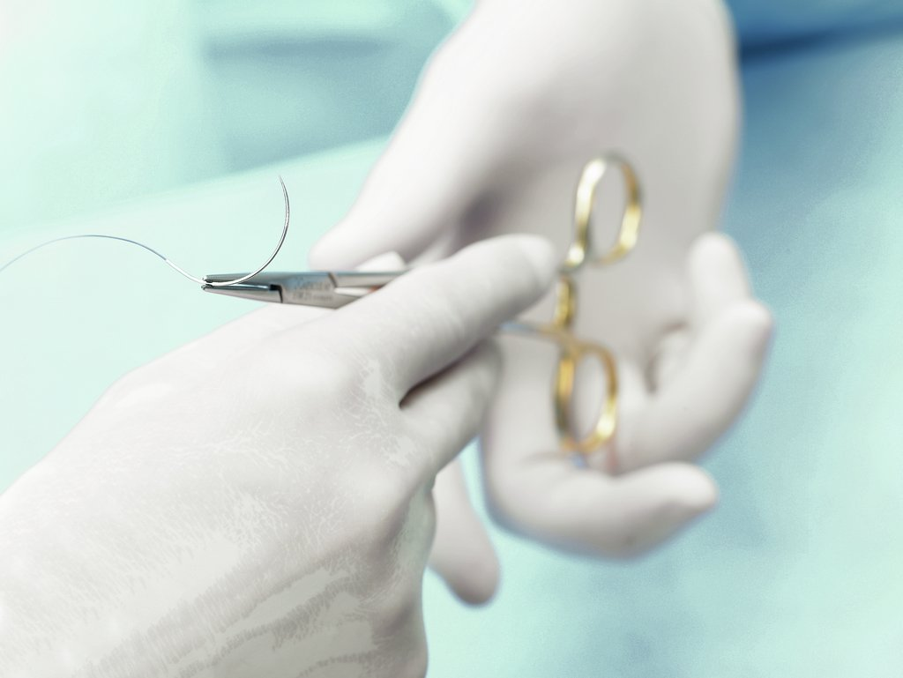
Surgical Needles
SIGMUM

Slide 21
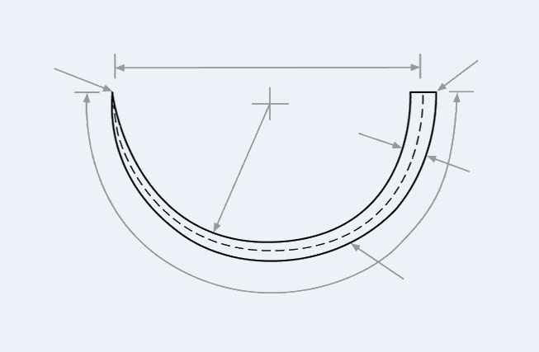
Anatomy of Needle
Chord length
Arming zone
Needle point
Needle radius
Needle diameter
Needle curvature
Needle body
Needle length
SIGMUM

Slide 22
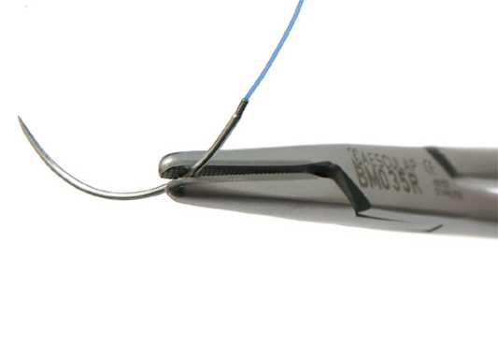
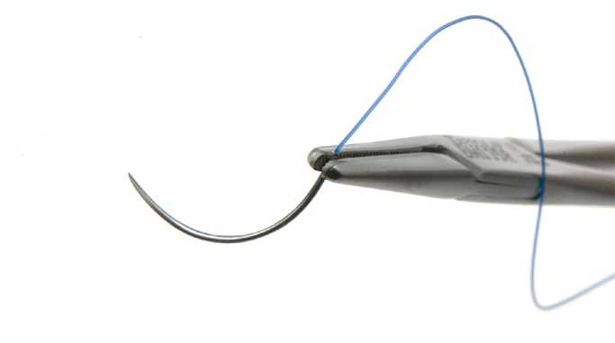
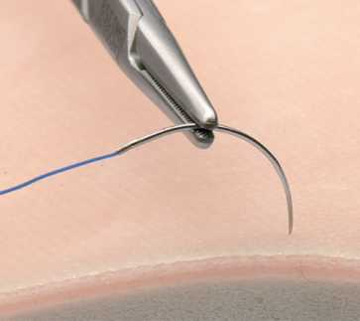
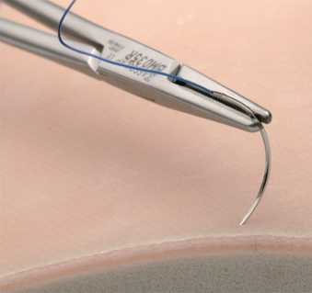
Holding the needle
90° angle
RIGHT
WRONG
RIGHT
WRONG
When penetrating the tissues, always hold the needle tip at an angle of 90° to the tissue’s surface. This will ensure the optimal hold of the tissues being sutured.
SIGMUM

Slide 23
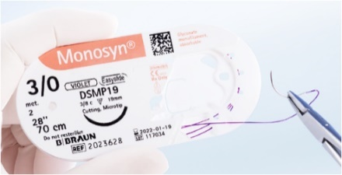
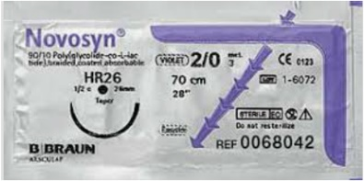
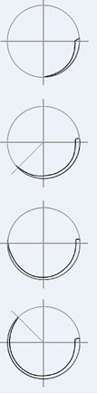






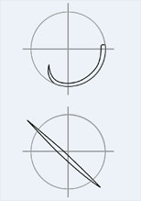
Needle Curvature
- 1st alphabet
Shape | Applications
1/4 circle (V) | Ophthalmologic and microsurgical operations
3/8 circle (D) | Vascular vessels, biliary ducts, urinary ducts, skin(Intradermic), MIS, ophtalmic, tendons etc.
1/2 circle (H) | Gastrointestinal tract, vascular vessels, abdominal wall, cardiac surgery, tendons, muscular layers, urogenital tract. Is the most used shape to close the surgical layers in all surgical specialities
5/8 circle (F) | Urogenital tract, pelvic organs, closure of narrow and deep incisions
Skin
Internal tissue
Progressive (P) | CABG(Vascular anastomosis in coronary artery bypass)
Straight (G) | Gastrointestinal tract(purse string sutures), tendons, skin
SIGMUM

Slide 24

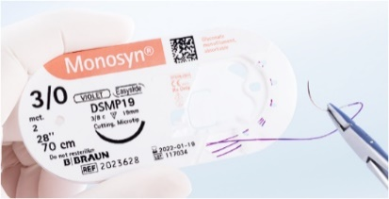
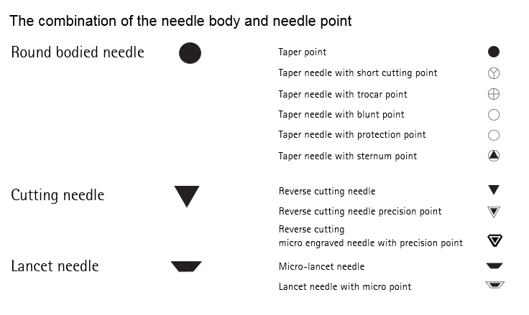
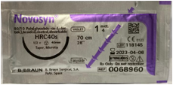
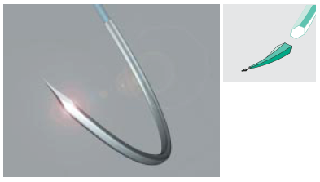
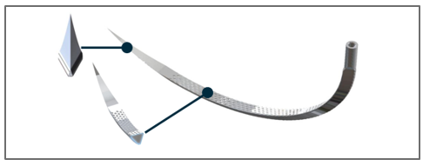
Needle Body Types
Dermaslide Needle
SIGMUM

Slide 25
Suture Portfolio
Sutures
Absorbable
Non-Absorbable
Natural
Synthetic
Monofilament
Monofilament
Braided
Short Term
Monosyn® Quick
Mid Term
Monosyn®
Long Term
MonoPlus®
Extra Long Term
Monomax®
Short Term
Novosyn® Quick
Mid Term
Novosyn®
Short Term
Catgut® Plain
Mid Term
Catgut® Chrom
Natural
Synthetic
Monofilament
Braided
Steelex®
Silkam®
Monofilament
Braided
Optilene®
PremiCron®
Dafilon®
SIGMUM

Slide 26
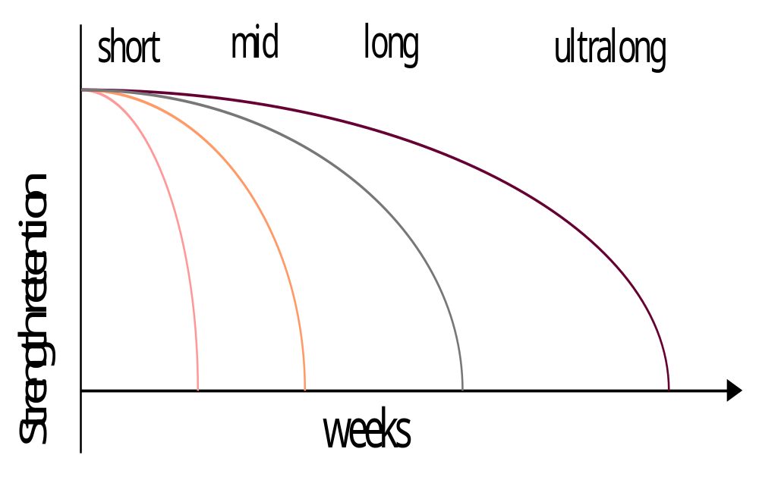
Complete range of Monofilament and Braided sutures for all indications
Braided
Novosyn®
Quick
Novosyn®
Monosyn®
Quick
Monosyn®
Monoplus®
MonoMax®
Monofilament
Day
Skin Closure
Episiotomies
Circumcision
Oral Mucosa
& others fast
healing tissues
G.I. Anastomosis
Subcutaneous layer
Muscular layer
Skin closure
Ligatures
Slow healing Tissues where an extended wound support of more than 4 weeks is desirable
Abdominal
Wall Closure
SIGMUM

Slide 27
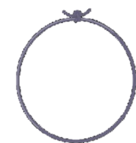
Summary
Suture Material
Suture Size
Needle Types
Needle Size
5
Histoacryl
4
Monosyn / Monosyn Quick
4/0 – 3/0
3/8 Cutting
(DS, DSMP, DGMP)
19 – 24 mm
3
Monosyn / Novosyn
3/0 – 2/0
1/2 Round Bodied (HR)
26 mm
2
Novosyn / MonoPlus
2/0 - 1
1/2 Round Bodied (HR, HRC)
37 - 43 mm
1
Monomax
0 - 1
1/2 Round Bodied (HR, HRC)
40 – 48 mm
SIGMUM

Slide 28





Specialties Range
Histoacryl tissue adhesive
Manipler Skin stapler
Lyostypt Collagen hemostat
Optilene Mesh for Hernia Repair
Lapfix for laparoscopic
Hernia mesh fixation
SIGMUM

Slide 29

Histoacryl ® flexible
SIGMUM

Slide 30


Histoacryl® Flexible
Histoacryl® Flexible
Composition
Colour
Storage Temperature
Description
Sizes
Indications
  Tissue adhesive and microbiological barrier product
  n-butyl-cyanoacrylate + softener
  Skin Closure (<25cm)
  Blue (D&C Violet No2)
  0.5 ml ready-to-use ampoule
  Room temperature (25⁰C)
Applicator
  Applicator Tip
SIGMUM

Slide 31



Histoacryl® Flexible
Advantages
2. Microbial barrier
100% effective for 7 days ^{2,11}
  Staphylococcus aureus
  Staphylococcus epidermidis
  Escherichia coli
  Pseudomonas aeruginosa
  Enterococcus faecium
  Brevundimonas diminuta
  Candida albicans
1. Flexibility
Allows closure of incisions up to 25 cm ^{1, 8}
3. Quick and Easy:
skin wound closure in 30seconds⁷ ; ready to use product stored at room temperature
4. High Strength
Requires only one layer of adhesive to achieve a full strength bond
5. Water-resistant:
patient is allowed to shower but prolonged soaking should be avoided
6. Excellent cosmetic result :
high patient
satisfaction^{3,4,5,6}
30 secs
SIGMUM

Slide 32









Histoacryl® for skin closure
Laceration
Thyroidectomy
skin closure
Trocar site closure (lap chole/
lap cystectomy/lap
myomectomy/
lap urology/lap appendix etc)
Chemo Access port
chamber and puncture site
Breast surgery (can
start with Lumpectomy
skin closure)
C-sec skin closure
IV catheter insertion site
& under IV catheter hub
Arteriovenous Fistula (AVF)
skin closure
SIGMUM

Slide 33

HISTOACRYL®
Atraumatic Mesh Fixation with LAPFIX
SIGMUM

Slide 34

Product Features
Syringe Luer Lock compatible with Histoacryl®.
Cannula from current Histoacryl®. Metallic, marked with Histoacryl® brand, specially designed point, protector for trocar introduction.
Histoacryl® ampoule.
SIGMUM

Slide 35


Application – How to use
  Point wise fixation with small drops every 2 cm¹
  Glue drop should be placed 10 mm from mesh edge.
  6-8 drops for 10 x 15 cm mesh.
  Pull tip away from mesh after few seconds when glue starts to harden.
  If the tip get block, cut a small piece.
  Difficult access: Try to place it in 45ºC from the mesh.
SIGMUM
35
1. Helbling C, Schlumpf R. Hernia. 2003;7(2);80-4.

Slide 36





Take Home Message
Histoacryl Mesh Fixation
Good fixation
Prevent complications
Easy to use
Affordable
SIGMUM

Slide 37
Sutures
Thank
You
SIGMUM

